Slide 1
Controlling Multiple Omnimagnet
Mohamed Ghori

Slide 2
Graph KEY
Small → is y-axis of magnetic field
Large → is z-axis of magnetic field
dot is where the Ball has been

Slide 3
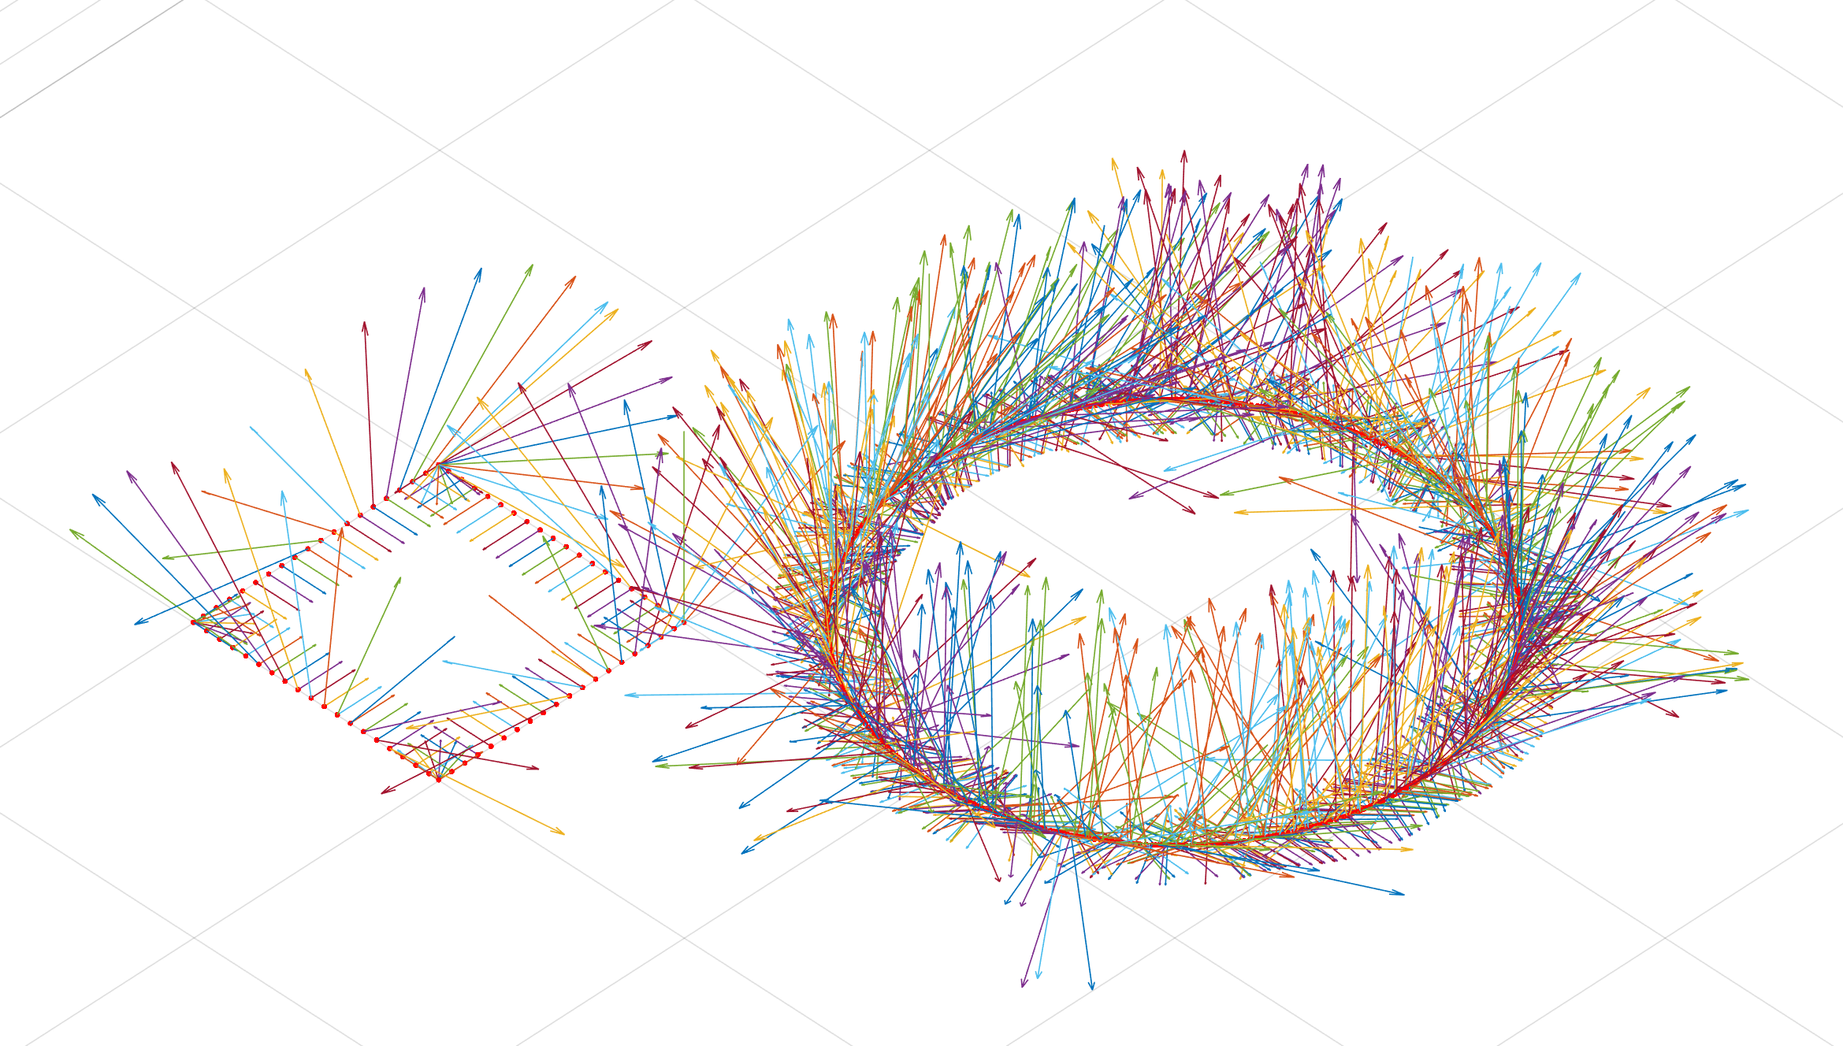
Final Outcome

Slide 4
Completed Tasks
Singularity avoided by placing ball away from point [0,0,0]
Sphere is controlled by phi(rotation about field y-axis) and psi(rotation about world z-axis)
invereMagneticField converts orientation to current
FwdMagneticField converts current to orientation
Ballfwd moves ball from point p1 to p2
rollBallInSquare rolls ball in a square with specified corners [x0,y0] [xf,yf]
plot_ball plots the ball and direction of z-axis(Large) and y-axis(small)
Note1: The equations in inverseMagneticField is not completely accurate since the M matrix(dimension of Omnimagnet) is set to a 3x3 Identity.
Note2: Need to double check equation to make certain all magnetic fields, including the tool (ball), are accounted for.

Slide 5
Code Controlling Ball
ballfwd:
function to move ball along a path given p0, pf, & wRb
Plot using plot_ball
Returns current through movement using inverseMagneticField
rollBallInSquare:
function that provides corners of rectangle
Plots & Returns currents using ballfwd
rollBallInCircle:
function that provides points on circle
Plots & Returns currents using ballfwd

Slide 6
Future

Slide 7
Future Goals 06.12.2016
Test Rotation & Translation in Function for extreme cases
Create a Playback Function based on current
Play code to ARBRITRARY STARTING ORIENTATION

